Slide 1
Machine learning for machine vision (Unsupervised Learning [Clustering])

Slide 2
Unsupervised learning
Unsupervised learning is a type of machine learning algorithm used to draw inferences from datasets consisting of input data without labeled responses.
The most common unsupervised learning method is cluster analysis, which is used for exploratory data analysis to find hidden patterns or grouping in data.

Slide 3
Unsupervised learning
Unsupervised learning is a type of algorithm that learns patterns from untagged data.
The goal for unsupervised learning is to model the underlying structure or distribution in the data in order to learn more about the data.
Unsupervised learning doesn't use training data. If you have known criteria that allow you to classify your data into useful categories.

Slide 4
Unsupervised learning (Key points)
The most common form of Unsupervised Learning is Clustering
K-means is a popular technique for Clustering. k-Means Clustering is an unsupervised learning algorithm that is used for clustering whereas KNN is a supervised learning algorithm used for classification.
PCA is an unsupervised method, meaning that it does not make use of any labels in the computation.
A neural net is said to learn supervised, if the desired output is already known.

Slide 5
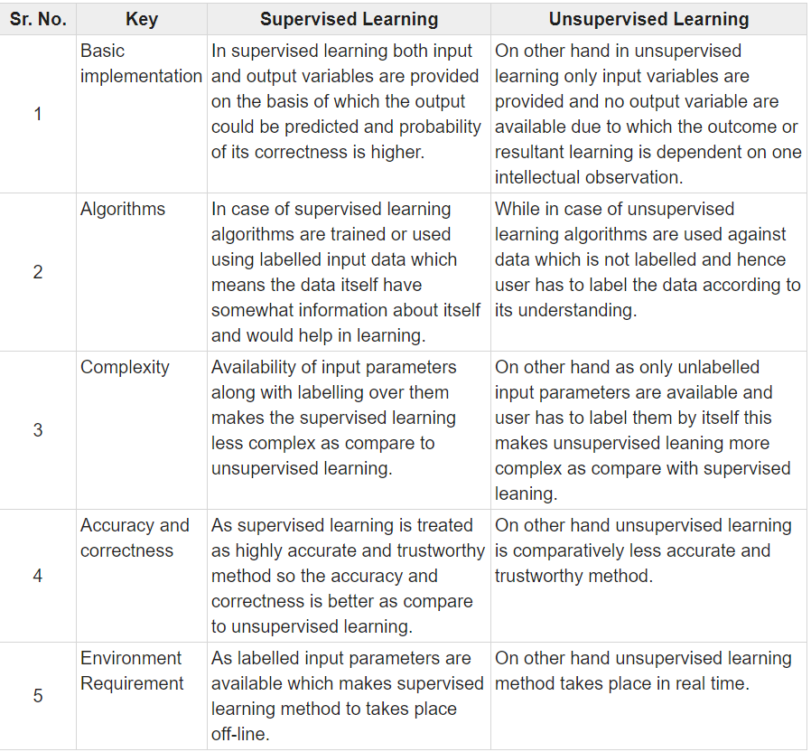
Supervised Vs Unsupervised

Slide 6
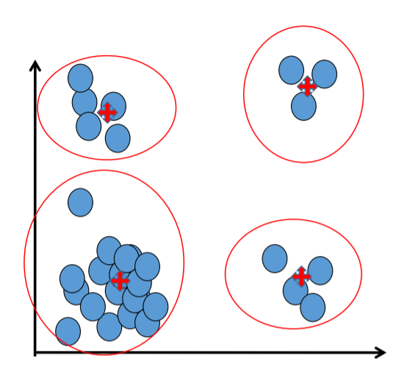
Cluster
A cluster is represented by a single point, known as centroid (or cluster center) of the cluster.
Centroid is computed as the mean of all data points in a cluster 𝐶𝑗 = 𝑥 𝑖.
Cluster boundary is decided by the farthest data point in the cluster.

Slide 7
Applications
Example 1: groups people of similar sizes together to make “small”, “medium” and “large” T-Shirts.
Tailor-made for each person: too expensive
One-size-fits-all: does not fit all.
Example 2: In marketing, segment customers according to their similarities
To do targeted marketing.
Example 3: Given a collection of text documents, we want to organize them according to their content similarities,
To produce a topic hierarchy

Slide 8
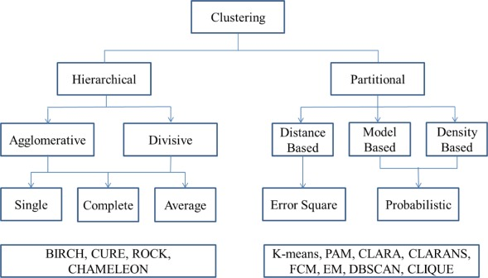
Clustering Techniques

Slide 9
Types of clustering
Clustering: Task of grouping a set of data points such that data points in the same group are more similar to each other than data points in another group (group is known as cluster).
Types:
1. Exclusive Clustering: K-means
2. Overlapping Clustering: Fuzzy C-means
3. Hierarchical Clustering: Agglomerative clustering, divisive clustering
4. Probabilistic Clustering: Mixture of Gaussian models

Slide 10
K-means clustering
K-means is a partitional clustering algorithm
Let the set of data points (or instances) D be
{x₁, x₂, …, x_{n}},
where x_{i} = (x_{i1}, x_{i2}, …, x_{ir}) is a vector in a real-valued space X ⊆ R^{r}, and r is the number of attributes (dimensions) in the data.
The k-means algorithm partitions the given data into k clusters.
Each cluster has a cluster center, called centroid.
k is specified by the user

Slide 11
K-means algorithm
Given k, the k-means algorithm works as follows:
Randomly choose k data points (seeds) to be the initial centroids, cluster centers
Assign each data point to the closest centroid
Re-compute the centroids using the current cluster memberships.
If a convergence criterion is not met, go to 2).

Slide 12
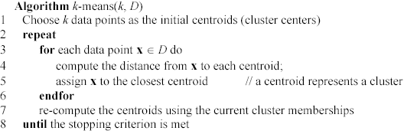
K-means algorithm – (cont …)

Slide 13
Stopping/convergence criterion
no (or minimum) re-assignments of data points to different clusters,
no (or minimum) change of centroids, or
minimum decrease in the sum of squared error (SSE),
C_{i} is the jth cluster, m_{j} is the centroid of cluster C_{j} (the mean vector of all the data points in C_{j}), and dist(x, m_{j}) is the distance between data point x and centroid m_{j}.
(1)

Slide 14
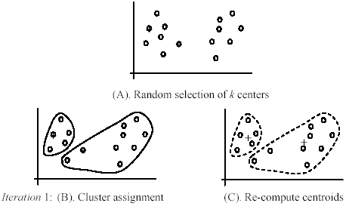
An example
+
+

Slide 15
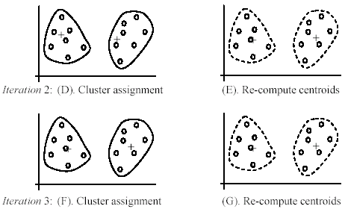
An example (cont …)

Slide 16
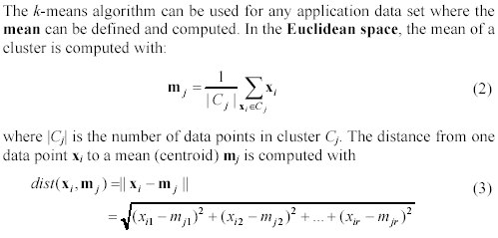
An example distance function

Slide 17
A disk version of k-means
K-means can be implemented with data on disk
In each iteration, it scans the data once.
as the centroids can be computed incrementally
It can be used to cluster large datasets that do not fit in main memory
We need to control the number of iterations
In practice, a limited is set (< 50).
Not the best method. There are other scale-up algorithms, e.g., BIRCH.

Slide 18
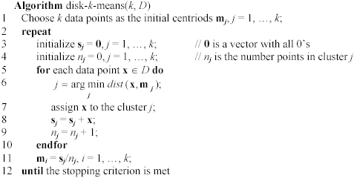
A disk version of k-means (cont …)

Slide 19
Strengths of k-means
Strengths:
Simple: easy to understand and to implement
Efficient: Time complexity: O(tkn),
where n is the number of data points,
k is the number of clusters, and
t is the number of iterations.
Since both k and t are small. k-means is considered a linear algorithm.
K-means is the most popular clustering algorithm.
Note that: it terminates at a local optimum if SSE is used. The global optimum is hard to find due to complexity.

Slide 20
Weaknesses of k-means
The algorithm is only applicable if the mean is defined.
For categorical data, k-mode - the centroid is represented by most frequent values.
The user needs to specify k.
The algorithm is sensitive to outliers
Outliers are data points that are very far away from other data points.
Outliers could be errors in the data recording or some special data points with very different values.

Slide 21
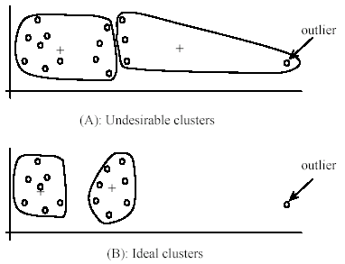
Weaknesses of k-means: Problems with outliers

Slide 22
Weaknesses of k-means: To deal with outliers
One method is to remove some data points in the clustering process that are much further away from the centroids than other data points.
To be safe, we may want to monitor these possible outliers over a few iterations and then decide to remove them.
Another method is to perform random sampling. Since in sampling we only choose a small subset of the data points, the chance of selecting an outlier is very small.
Assign the rest of the data points to the clusters by distance or similarity comparison, or classification

Slide 23
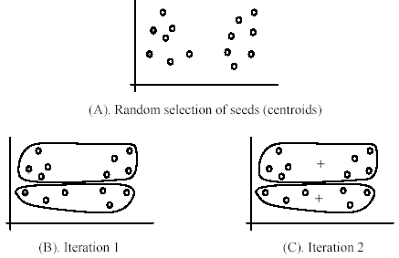
Weaknesses of k-means (cont …)
The algorithm is sensitive to initial seeds.

Slide 24
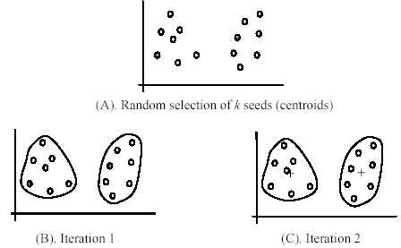
Weaknesses of k-means (cont …)
If we use different seeds: good results
There are some methods to help choose good seeds

Slide 25
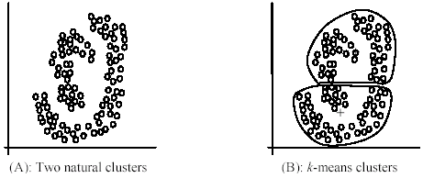
Weaknesses of k-means (cont …)
The k-means algorithm is not suitable for discovering clusters that are not hyper-ellipsoids (or hyper-spheres).
+

Slide 26
K-means summary
Despite weaknesses, k-means is still the most popular algorithm due to its simplicity, efficiency and
other clustering algorithms have their own lists of weaknesses.
No clear evidence that any other clustering algorithm performs better in general
although they may be more suitable for some specific types of data or applications.
Comparing different clustering algorithms is a difficult task. No one knows the correct clusters!

Slide 27
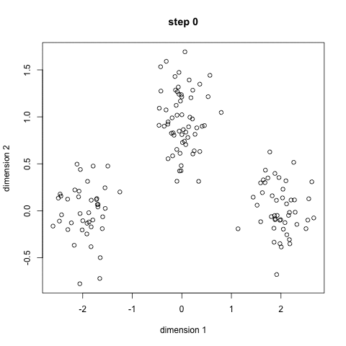
K-means

Slide 28
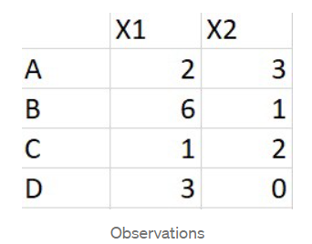
K-means example
Let us go through the k-means steps using the example below.
Consider 4 data points A,B,C,D as below
Choose two centroids AB and CD, calculated as

Slide 29
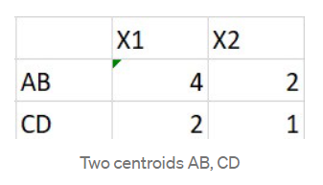
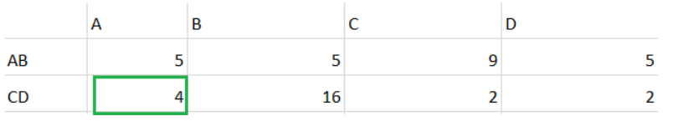
K-means example
2. Choose two centroids AB and CD, calculated as
AB = Average of A, B
CD = Average of C,D
3. Calculate squared euclidean distance between all data points to the centroids AB, CD. For example distance between A(2,3) and AB (4,2) can be given by s = (2–4)² + (3–2)².

Slide 30
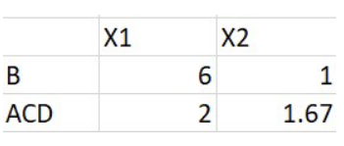
K-means example
4. If we observe in the fig, the highlighted distance between (A, CD) is 4 and is less compared to (AB, A) which is 5. Since point A is close to the CD we can move A to CD cluster.
5. There are two clusters formed so far, let recompute the centroids i.e, B, ACD similar to step 2.
ACD = Average of A, C, D
B = B

Slide 31
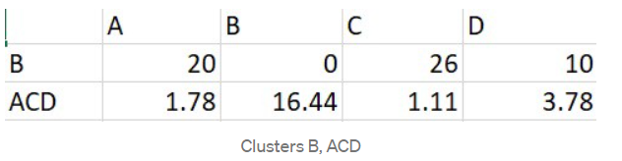
K-means example
6. As we know K-Means is iterative procedure now we have to calculate the distance of all points (A, B, C, D) to new centroids (B, ACD ) similar to step 3.
7. In the above picture, we can see respective cluster values are minimum that A is too far from cluster B and near to cluster ACD. All data points are assigned to clusters (B, ACD ) based on their minimum distance. The iterative procedure ends here.
8. To conclude, we have started with two centroids and end up with two clusters, K=2.

Slide 32
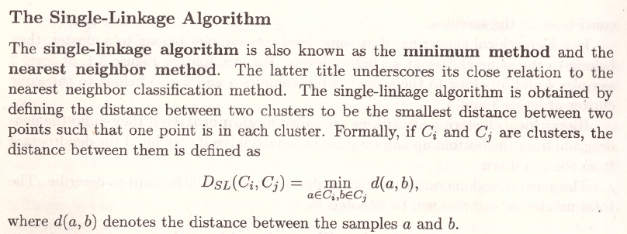
Hierarchical Clustering

Slide 33
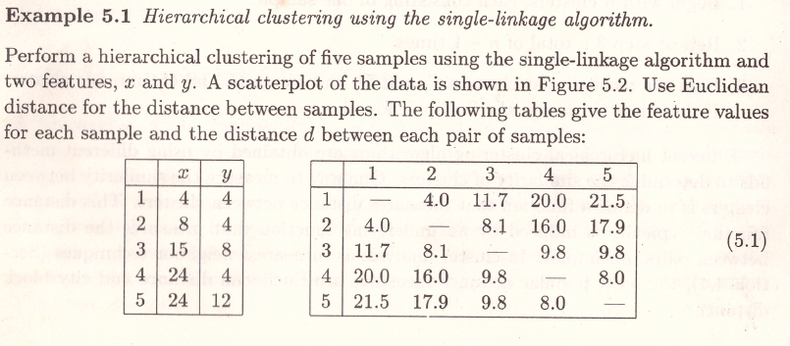
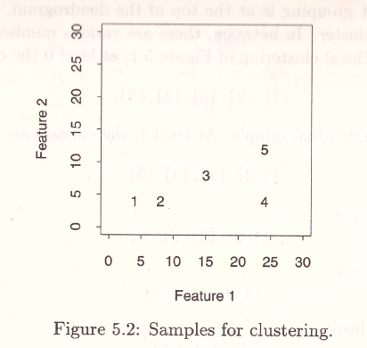
Hierarchical Clustering

Slide 34
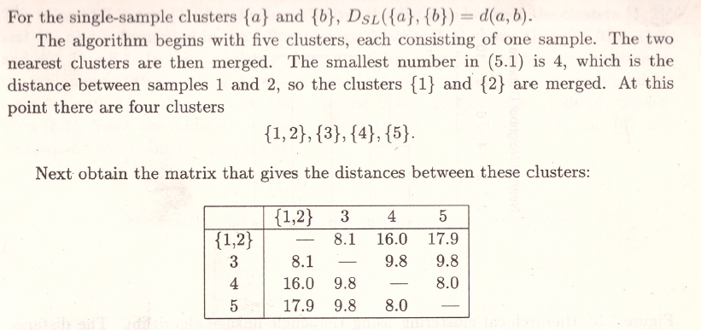
Hierarchical Clustering

Slide 35
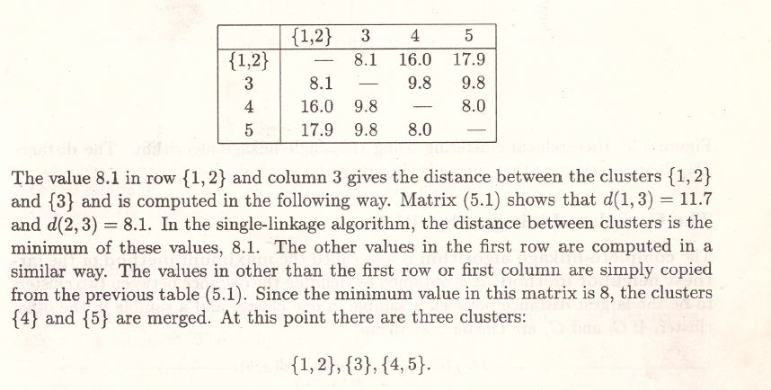
Hierarchical Clustering

Slide 36
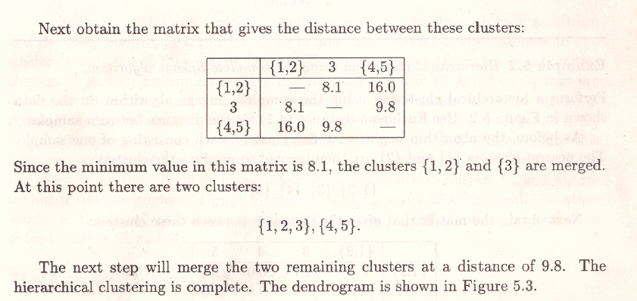
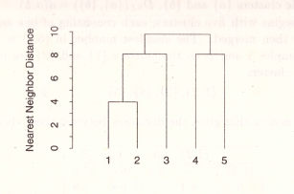
Hierarchical Clustering

Slide 37
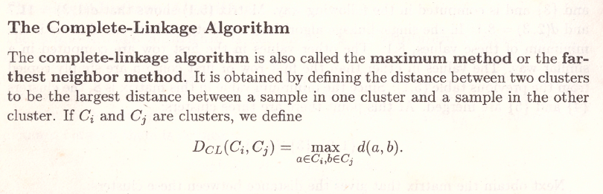
Hierarchical Clustering

Slide 38
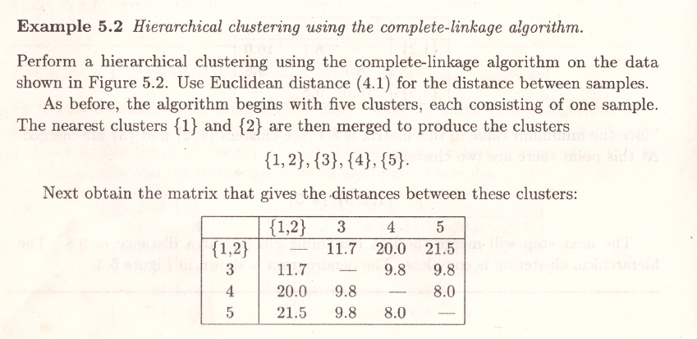
Hierarchical Clustering

Slide 39
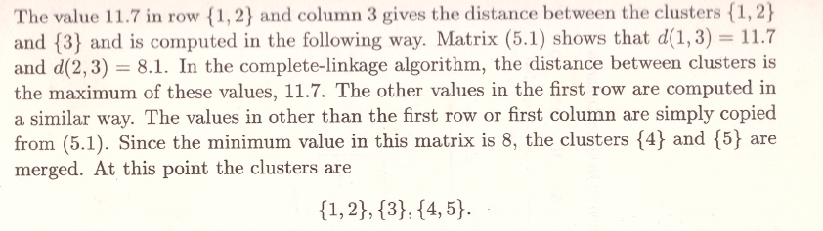
Hierarchical Clustering

Slide 40
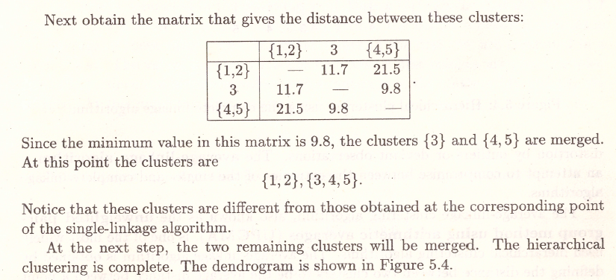
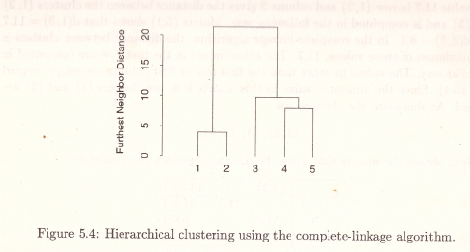
Hierarchical Clustering

Slide 41
Thank You

